Slide 1
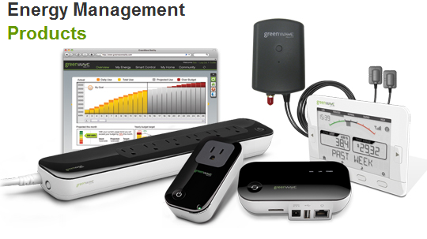
EMS Team Meeting
Johnny Nguyen
Camilo Aguilar
Christian Goldau
Andrew Wang
February 15, 2013

Slide 2
Milestones-Last Quarter
Able to recognize both individual devices, stored in database, and multiple, same devices (ie if there are two footfans fans, identifies there are two fans).
Used ADC, and compute different load signature characteristics on board

Slide 3
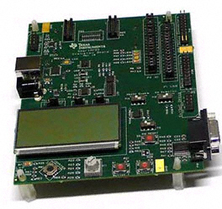
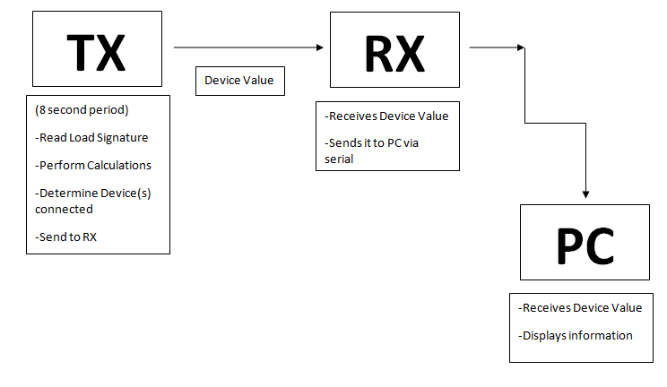

Real-Time Display

Slide 4
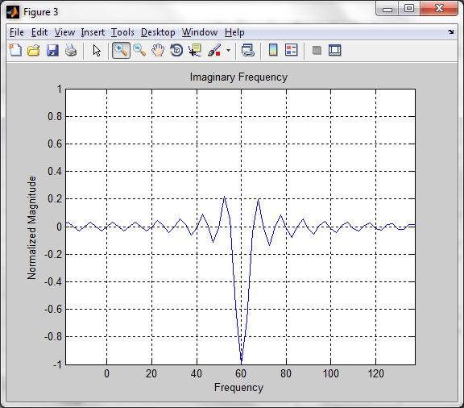
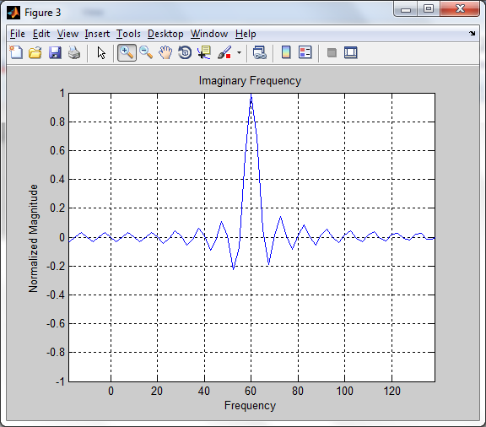
Load-Signature Algorithm: Real and Imaginary Frequency Harmonics
Problem: two sine waves, one with 180 degree shift, yielded different Phase, Real and Imaginary FFT
No Phase Shift 180 Degree Shift

Slide 5
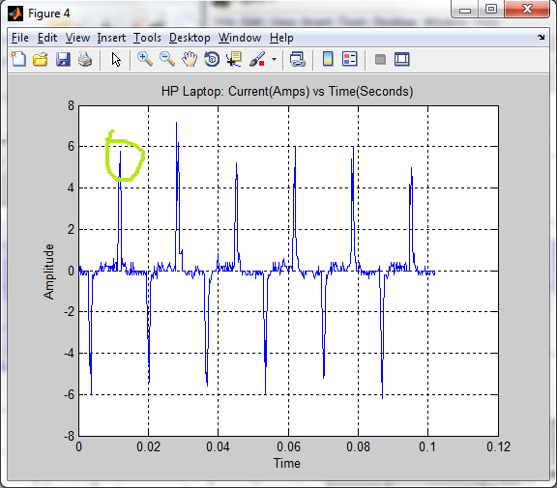
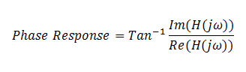
Problem Solved: Read waveform, store it into buffer, and set starting point to maximum at first period
Calculations consistent
However, sometimes phase was opposite signs
Thus we will use Real and Imaginary

